Slide 1
Network to Code

Slide 2

Network to Code
Founded in mid 2014
Network Automation Solution Provider
Next-gen consulting services company
Core focus on automation/programmability
Reducing operational inefficiencies
Training / Enablement Services
Python and Ansible for Network Engineers
DevOps Tools
Private/Public Courses/Bootcamps
Vendor Independent
Infrastructure (Cisco, Juniper, Arista, F5 etc.)
Tools (Ansible, Salt, Python, etc..)

Slide 3

Community Presence
Team
Industry Experts and Evangelists
Team of network engineers who made the transition to software engineers
Pioneers in Network Automation Community
Major content contributors and presenters at industry conferences, meet-ups, and online communities.
Over 4,200 members and 100s of channels in Network to Code Slack Community
Technology Partnerships
We’ve written thousands of Python Automation Modules, Playbooks, and Config templates, for our Vendor partner community
We believe in the value network automation brings to our customers and we our proud to share our knowledge with our community.

Slide 4
Monthly Meetup
All things network automation
Next one is March
Looking for Space and Sponsors
Topics:
Open Source Tools
Ansible, Salt, Puppet
Generic APIs: NETCONF, RESTCONF
Templating
Specific APIs: eAPI, NX-API, etc.
Data Modeling (YANG)
Vendor Products
Python
CI/CD Pipelines for network operations
…

Slide 5
Speakers
We want volunteers
Share what you’re been working on
From a basic script to full blown applications and automation
1-2 speakers for each meetup

Slide 6
Join the Community
Slack team dedicated to network automation
Self sign-up
slack.networktocode.com
Private local chat
Github
https://github.com/networktocode
https://github.com/itdependsnetworks/awesome-network-automation

Slide 7
Using Vendor & Platform Neutral Data Models with Ansible
Ken Celenza
@itdependsnet
ken@networktocode.com

Slide 8
Agenda
Introduction
Review last Meetup
Understand the need for a Data Model
Define steps to create Data Model
Work through Steps
Demo

Slide 9
Who am I?
Ken Celenza
Traditional network background
Was the token “scripting” guy
Started in 2000
USAF
Consultant
Enterprise
Now focuses only on network automation at NTC

Slide 10
Review
Ansible Components
Inventory
Variable Management & Credentials
Template and ios_config module
Playbook, Play, tasks
Demo
Build configurations based on template and vars
Deploy configurations to IOS devices

Slide 11
Data Model Overview
Purpose
Normalize of configuration or operational state between OS’s
Abstract the uniqueness of the OS implementation away from from intent
Express the most amount of operational state or configuration in the least amount of actual data *
Allows you to match business case/logic to configuration, rather than opposite
Complexity
OC/IETF Yang models are complex and meant to be fully featured
Demo is meant to be simplified and strategic
Data Types
Use appropriate data for each use case, serve different purposes
List is ordered, dictionary is a mapping
Format
JSON
YAML
XML

Slide 12
Transition Steps
Configuration is the current data model
The data model is not same between OS’s and version
Determine unique data
Determine data model that fits all use cases
Separate OS implementation details from Configuration intent
Create template from based on data model to create OS implementation details

Slide 13
Current Configuration/Data Model
IOS
router bgp 65000
bgp router-id 1.1.1.1
bgp log-neighbor-changes
neighbor 10.1.1.2 remote-as 65000
neighbor 10.1.1.2 description NYC-RT02
address-family ipv4
network 1.1.1.0 mask 255.255.255.0
network 10.1.1.0 mask 255.255.255.0
neighbor 10.1.1.2 activate
exit-address-family
NXOS
router bgp 65000
router-id 2.2.1.1
address-family ipv4 unicast
network 2.2.2.0/24
network 10.1.1.0/24
neighbor 10.1.1.1 remote-as 65000
description NYC-RT01
address-family ipv4 unicast
IOSXR
router bgp 65000
bgp router-id 3.3.1.1
address-family ipv4 unicast
network 3.3.1.0/24
network 10.1.1.0/24
neighbor 10.1.1.4
remote-as 65000
description NYC-RT04
address-family ipv4 unicast
JUNOS
set routing-options router-id 4.4.4.1
set routing-options autonomous-system 65000
set protocols bgp export allow-bgp
set protocols bgp group ibgp type internal
set protocols bgp group ibgp local-address 10.1.1.4
set protocols bgp group ibgp peer-as 65000
set protocols bgp group ibgp neighbor 10.1.1.3

Slide 14
Unique Data
IOS
router bgp 65000
bgp router-id 1.1.1.1
bgp log-neighbor-changes
neighbor 10.1.1.2 remote-as 65000
neighbor 10.1.1.2 description NYC-RT02
address-family ipv4
network 1.1.1.0 mask 255.255.255.0
network 10.1.1.0 mask 255.255.255.0
neighbor 10.1.1.2 activate
exit-address-family
NXOS
router bgp 65000
router-id 2.2.1.1
address-family ipv4 unicast
network 2.2.2.0/24
network 10.1.1.0/24
neighbor 10.1.1.1 remote-as 65000
description NYC-RT01
address-family ipv4 unicast
IOSXR
router bgp 65000
bgp router-id 3.3.1.1
address-family ipv4 unicast
network 3.3.1.0/24
network 10.1.1.0/24
neighbor 10.1.1.4
remote-as 65000
description NYC-RT04
address-family ipv4 unicast
JUNOS
set routing-options router-id 4.4.4.1
set routing-options autonomous-system 65000
set protocols bgp export allow-bgp
set protocols bgp group ibgp type internal
set protocols bgp group ibgp local-address 10.1.1.4
set protocols bgp group ibgp peer-as 65000
set protocols bgp group ibgp neighbor 10.1.1.3

Slide 15
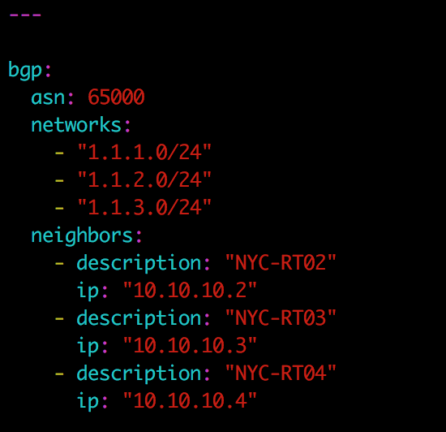
Build Your Data Model
Need an anchor key: bgp
Must have a single ASN: key/val
Can have multiple networks: list
Each neighbor will have contain multiple pieces of information: list of dictionaries

Slide 16
BGP Data Model Implementation
IOS
bgp:
asn: 65000
networks:
- "1.1.1.0/24"
- "1.1.2.0/24”
neighbors:
- description: "NYC-RT02"
ip: "10.10.10.2”
NXOS
bgp:
asn: 65000
networks:
- "1.1.1.0/24"
- "1.1.2.0/24”
neighbors:
- description: "NYC-RT02"
ip: "10.10.10.2”
IOSXR
bgp:
asn: 65000
networks:
- "1.1.1.0/24"
- "1.1.2.0/24”
neighbors:
- description: "NYC-RT02"
ip: "10.10.10.2”
JUNOS
bgp:
asn: 65000
networks:
- "1.1.1.0/24"
- "1.1.2.0/24”
neighbors:
- description: "NYC-RT02"
ip: "10.10.10.2”

Slide 17
Template
IOS
router bgp {{ bgp['asn'] }}
bgp router-id {{ bgp['id'] }}
bgp log-neighbor-changes
{% for neighbor in bgp['neighbors'] %}
neighbor {{ neighbor['ip'] }} remote-as {{ neighbor['asn'] }}
neighbor {{ neighbor['ip'] }} description {{ neighbor['description'] }}
{% endfor %}
address-family ipv4
{% for net in bgp['networks'] %}
network {{ net | ipaddr('network') }} mask {{ net | ipaddr('netmask') }}
{% endfor %}
{% for neighbor in bgp['neighbors'] %}
neighbor {{ neighbor['ip'] }} activate
{% endfor %}
exit-address-family
NXOS
router bgp {{ bgp['asn'] }}
router-id {{ bgp['id'] }}
address-family ipv4 unicast
{% for net in bgp['networks'] %}
network {{ net }}
{% endfor %}
{% for neighbor in bgp['neighbors'] %}
neighbor {{ neighbor['ip'] }} remote-as {{ neighbor['asn'] }}
description {{ neighbor['description'] }}
address-family ipv4 unicast
{% endfor %}

Slide 18
Generating Configurations
Templates
OS Implementation Details
Data Variables
Device Details
Final Configuration

Slide 19

Generating Configurations
Templates
OS Implementation Details
Data Variables
Device Details
Final Configuration
Rendering Engine
Ansible
Python
…
Deploy Configuration

Slide 20
Demo
Using Vendor & Platform Neutral Data Models with Ansible

Slide 21
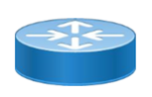
Topology – iBGP
NYC-RT01
172.16.1.101
IOS
NYC-RT02
172.16.1.102
IOSXR
1.1.1.0/24
1.1.2.0/24
1.1.3.0/24
2.2.1.0/24
2.2.2.0/24
2.2.3.0/24
10.1.1.1
10.1.1.2
ASN: 65000
NYC-RT03
172.16.1.103
NXOS
NYC-RT04
172.16.1.104
JUNOS
3.3.1.0/24
3.3.2.0/24
3.3.3.0/24
10.1.13
10.1.1.4
4.4.1.0/24
4.4.2.0/24
4.4.3.0/24

